Slide 1
ENGINEERING COLLEGE
Department of
Colorectal Cancer Detection Based on Convolutional Neural Networks (CNN) and Ranking Algorithm
Domain:
Deep Learning, Computer vision
Team Members:
R. Pavithra

Slide 2
INTRODUCTION
With the development of targeted therapies, many treatments are based on molecular studies, which require sampling tumour tissue from paraffin blocks for sequencing. An automated solution could potentially reduce the workload of pathologists by acting as a screening device and may reduce the subjectivity in diagnosis. In tissue-based diagnostics, most of the work still needs to be done manually by a pathologist using a microscope to examine stained slides. The foundation of such tasks is to accurately distinguish cancer/malignant cells from normal/benign cells. However, the determination of tumour content is poorly reproducible with significant variation. As the size of tumour regions can be very small, pathologists are often required to use high magnification for detecting tumour cells. This requirement significantly increases the workload for pathologists. As digital pathology datasets have become publicly available and have opened up the possibility of evaluating the feasibility of applying deep learning techniques to improving the efficiency and quality of histologic diagnosis. In this project we introduce an application to detect Colorectal cancer based on Convolutional Neural Network and Ranking algorithm.

Slide 3
Existing System
In the existing system , the concept of data mining systems supported on cancer prophecy system merging the prediction scheme with mining tools. The categorization algorithms used in the existing system is called decision tree. The user enters into the cancer prophecy scheme, and then required to retort the queries, connected to genetic and non-genetic skin textures. In that case the prediction structure allots the hazard rate to both query bases on the client retorts. One time the exposure significance is estimated, the series of the coercion preserve is resolute by the forecast structure. Research data shows that the accuracy of cancer prediction system is about 73%.

Slide 4
Objective of the project/Proposed System
In this project we build an Web Application powered by Amazon EC2 Linux instance to display Predicted Result from the SQL Database. The input image data sets are converted to gray scale image and further Segmentation and Morphological filtering is performed on image data using Matlab. The processed image is converted to dataset after applying Clustering and Ranking Algorithms. extracted facial dataset is passed to an model trained using Convolutional neural network (CNN) with increasing EPOCH. The model is trained With the help of pre-trained data stored in Key-Value pair in Mongo DB. Once the prediction is done the predicted values are stored in LSTM for future and fast processing. Cancer stage identification is done with the help of Ranking result and is updated in MySQL Database for backend services like Flask to fetch and propagate in user interface portal. Performance of the system is increased with encouraging results of initial experiments. The ultimate goal of this project is that An automated solution could potentially reduce the workload of pathologists by acting as a screening device and may reduce the subjectivity in diagnosis.

Slide 5
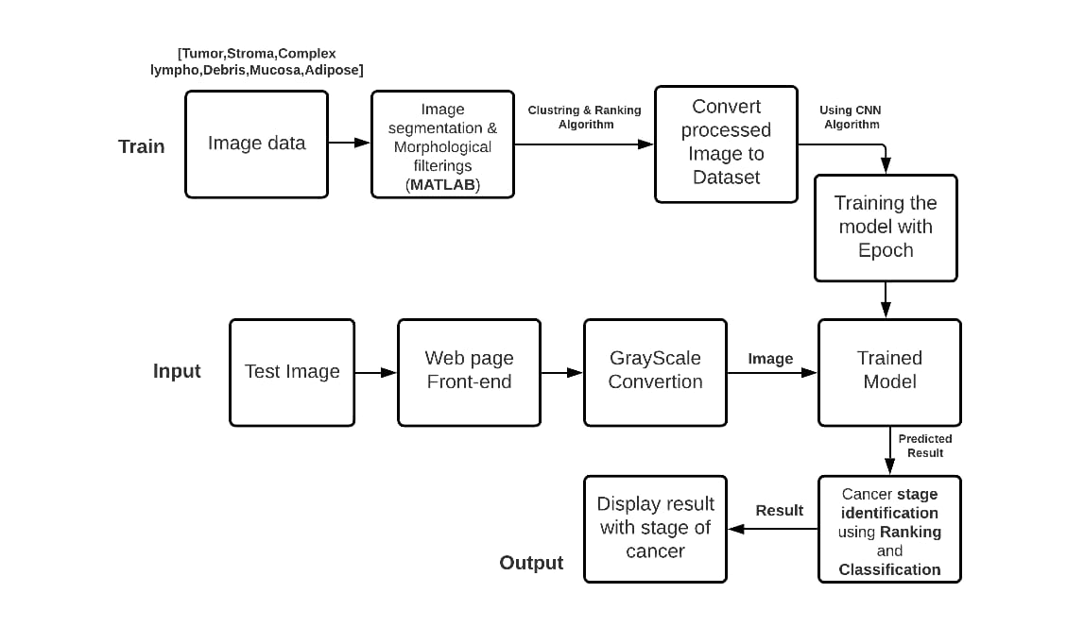
Block diagram of Methodology used

Slide 6
TECHNOLOGY STACK
Long Short-Term Memory (LSTM)
+
Convolutional Neural Networks (CNN)
Deep Learning ->
Web page
{
Front end
->
Flask + Amazon EC2

Slide 7
Proposed System
Proposed a CNN + LSTM simulator model using python to identify colorectal cancer affected tumour tissue
Tissues are classified into 7 types Tumour, Stroma, Lympho, Adipose, Complex, Debris, Mucosa
These seven types are used to identify the stage
According to datasheet from cancer.net stage of cancer is classified as three types Tumour(T), Node(N), Metastasis(M).
7

Slide 8
Proposed System
Stages are classified based on similarity in multiple tissue types
Combination of these 7 types [Tumour, Stroma, Lympho, Adipose, Complex, Debris, Mucosa] gives us the stage
This is achieved using CNN and LSTM where CNN trains the model to predict the tumour similarity and LSTM helps in identifing
8

Slide 9
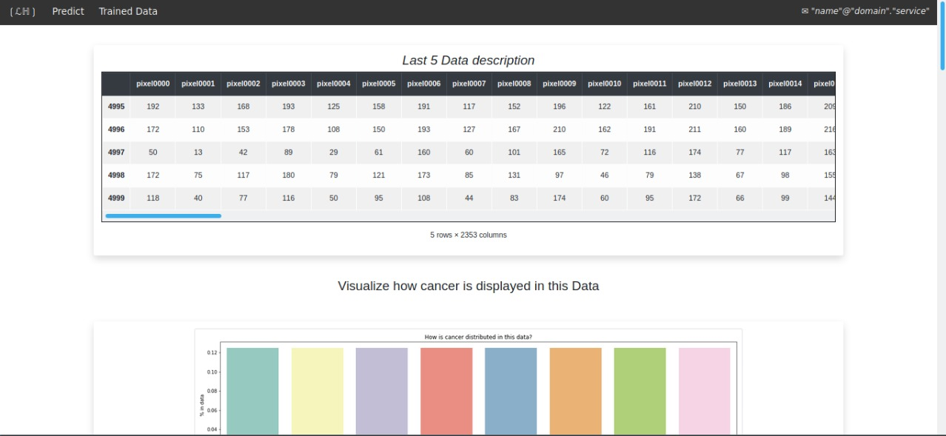
System Progress
9

Slide 10
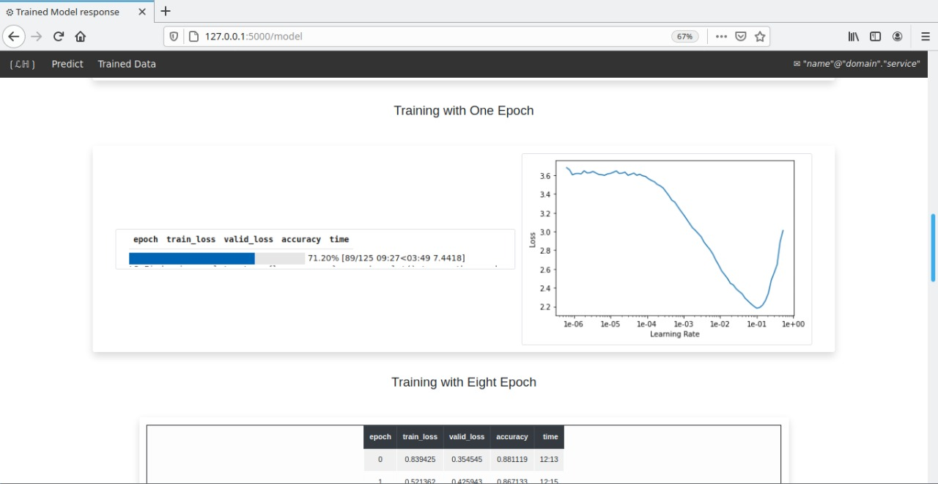
System Progress
10

Slide 11
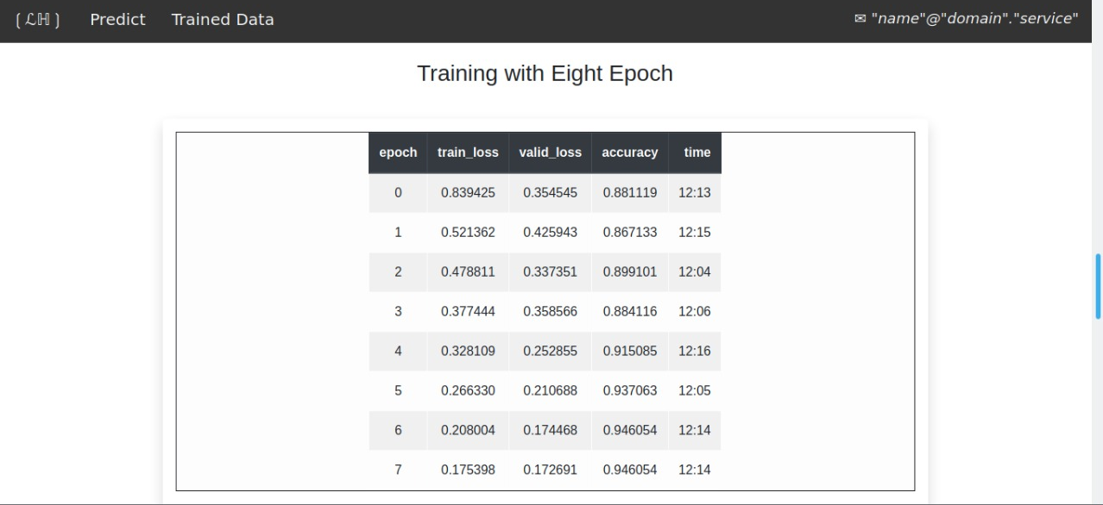
System Progress
11

Slide 12
Application and use case
reduce the workload of pathologists by acting as a screening device and also reduce the subjectivity in diagnosis.
Inclusion of feature in Scanning Devices for Quick analysis
possibility of evaluating the feasibility of applying deep learning techniques to improving the efficiency and quality of histologic diagnosis.

